Slide 1
Getting Your DB Schema Under Control With SSDT
Peter A. Schott

Slide 2

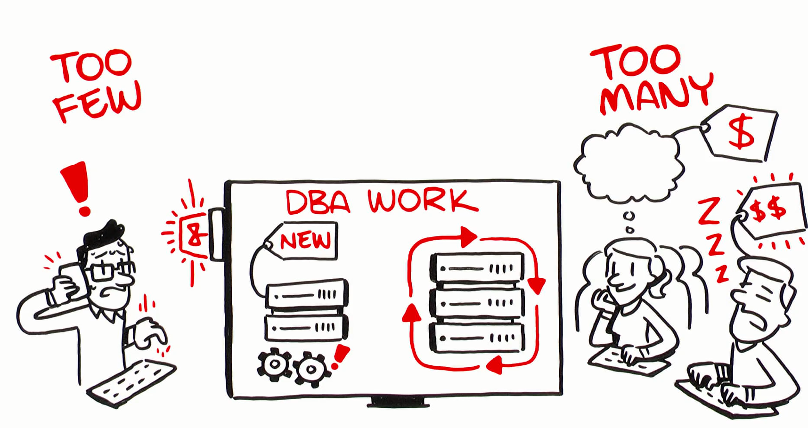
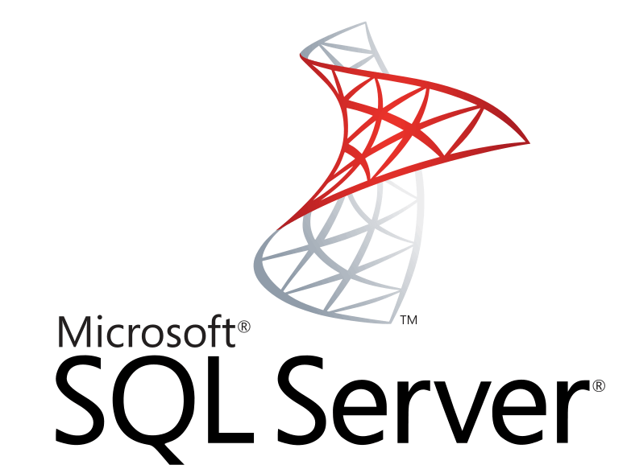





Our Niche
“We provide senior level DBAs to support to our customers for maximum flexibility in a model that aligns costs with usage.”
Service Features
Experienced, Assigned DBAs
100% U.S. Citizens
Direct Contact with DBAs
24x7 Incident Response
Integrated operational monitoring (optional)
Performance monitoring/assessment (optional)
Weekly Activity/Usage Reports
Service Benefits
Scalable DBA extension to team
No hiring or training costs
Pay-for-use model

Slide 3
Intro to SSDT
What is SSDT?
Brief history
Why would you use it?
SSIS
SSAS
SSRS
Databases
Notes:
VS DB Projects – large files, long build/compare times
SSDT – split into SSDT (DB Projects) and SSDT-BI – lots of confusion. BI Projects were version-specific
Current SSDT release – DB Projects, SSIS, SSAS, SSRS – can handle multiple (modern) SQL Versions
This presentation – DB Projects. Why? To get control of your schema in files that can go into source control.

Slide 4
Installing SSDT
Official source – Microsoft SSDT or VS
Use “Chocolatey”
Don’t need VS installed – will install a VS shell or Community Edition
Only install components/extensions you need/use
DB Projects installed by default
DB Projects also included in full Visual Studio 2015+ installs
Notes:
https://docs.microsoft.com/en-us/sql/ssdt/download-sql-server-data-tools-ssdt
Or use Chocolately to install VS shell + ssdt.
choco install visualstudio2019community
choco install visualstudio2019-workload-databuildtools --package-parameters "--no-includeRecommended"

Slide 5
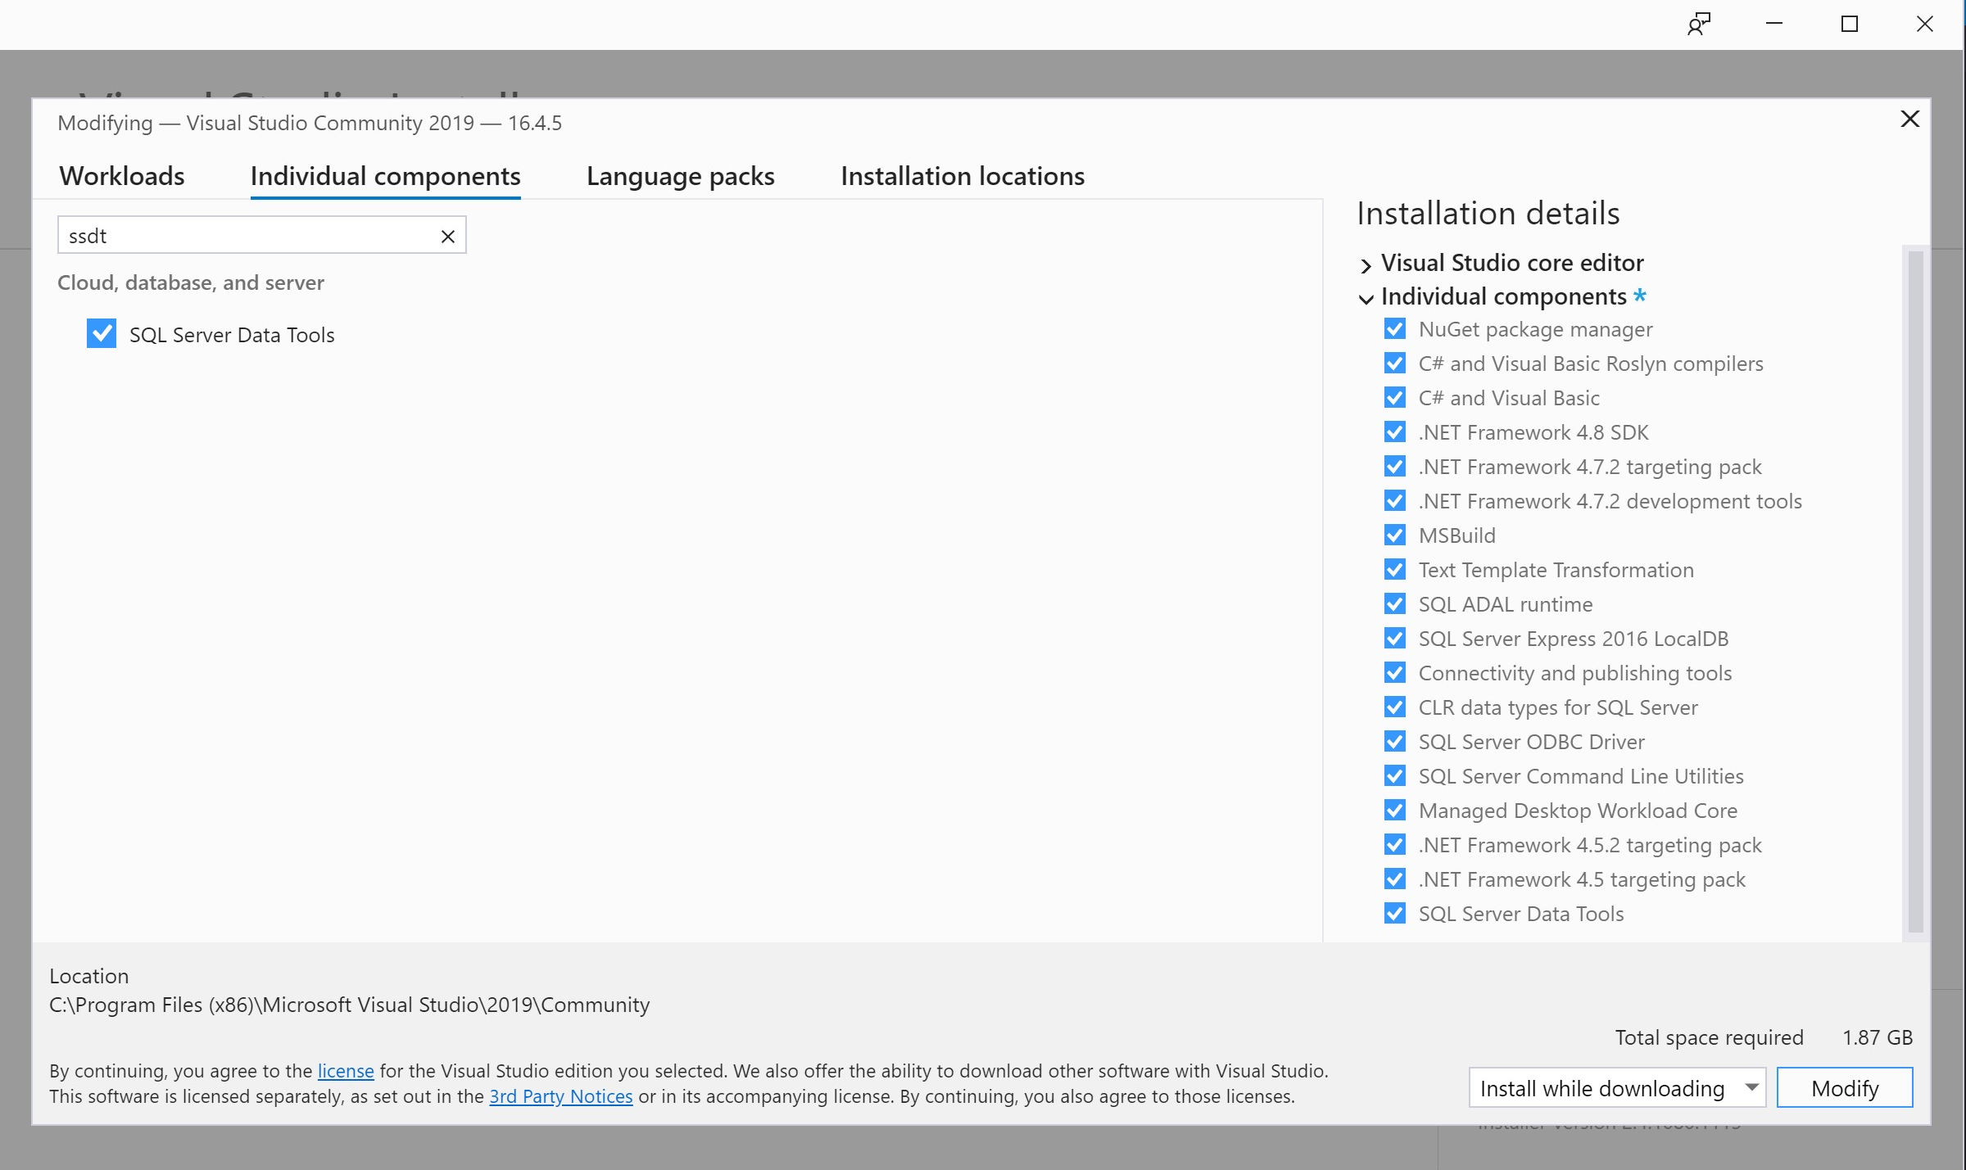
Visual Studio 2019
Visual Studio 2019 started using Extensions. Modify your install to add SSDT
Notes:
choco install visualstudio2019-workload-databuildtools --package-parameters "--no-includeRecommended“

Slide 6
Demo Time!
Notes:
Will cover the next several slides – create project, import db, explore project

Slide 7
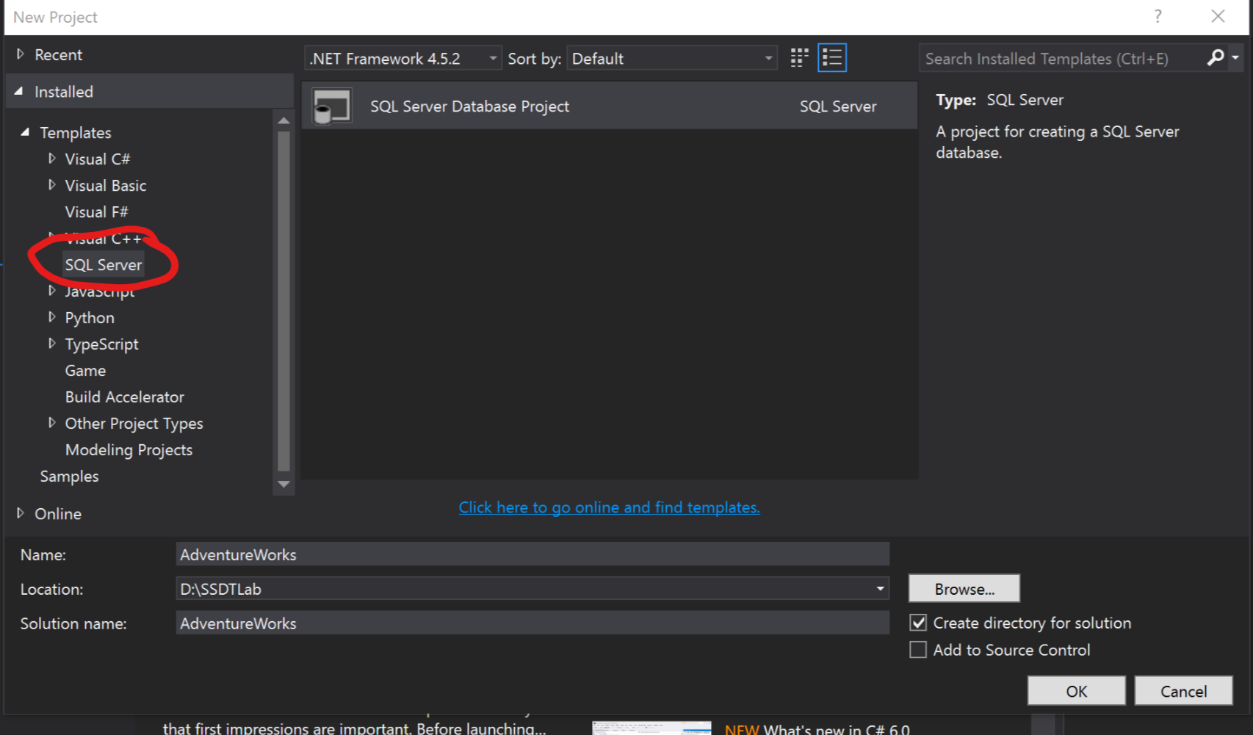
Creating Your First Project
Demo
Standard VS Shell
SQL Projects
May want to consider Templates
Notes:
Launch VS
New Project – type “SQL Server”
Can save Templates to the VS Templates folder if you have a setup you like and want to use for everything.
I’ll usually add folders in the project for “Publish” and “Schema Compare” as well as Pre/Post-deploy script folders

Slide 8
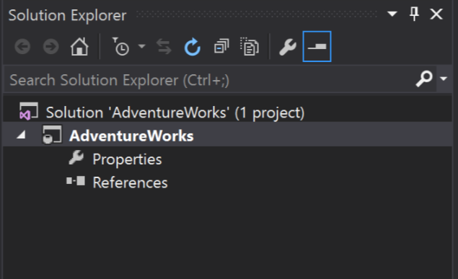
Now What?
Demo
Empty projects don’t give you a lot of guidance
Creating objects in an empty project can lead to poor structure
For best results, consider Importing

Slide 9
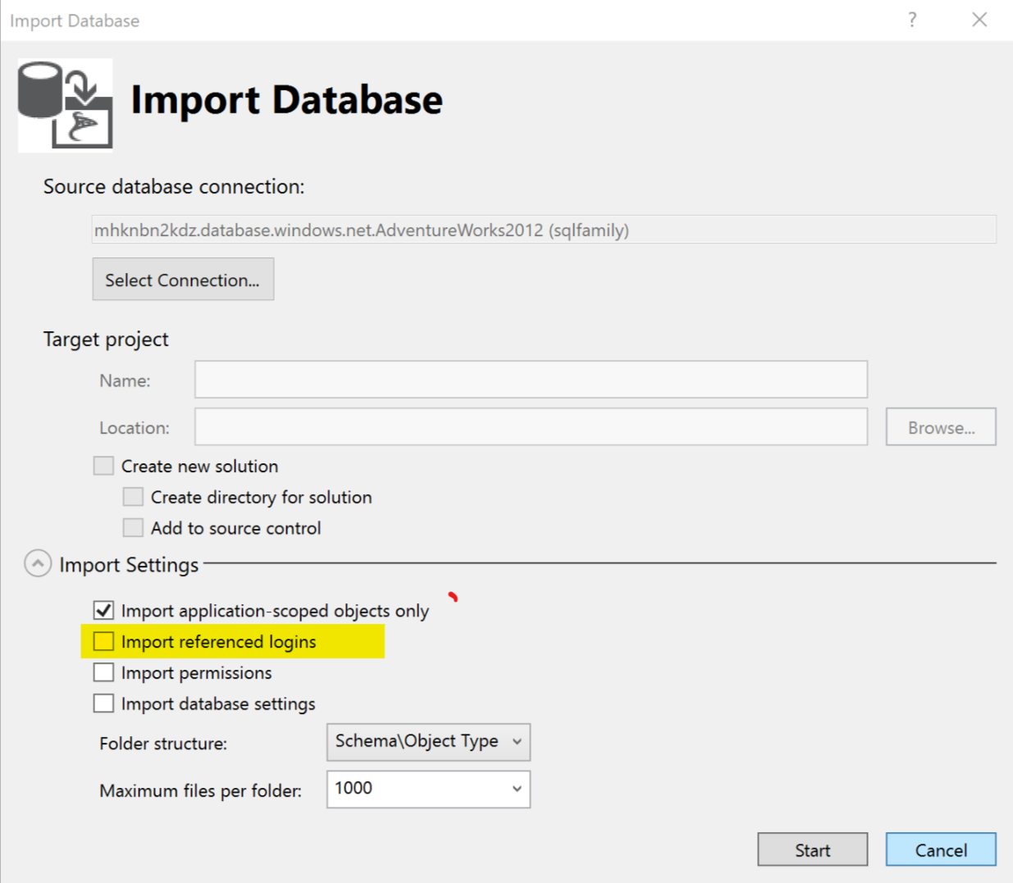
Importing Your Database Objects
Demo
Pulls in everything
Gives you a good starting structure
You’ll find lots of things to fix
Notes:
Can only import from DB/dacpac in an empty project (or brand new template)
Can always import from script, though only CREATE scripts will work.
Tend to avoid importing logins and permissions – those are usually environment-specific

Slide 10
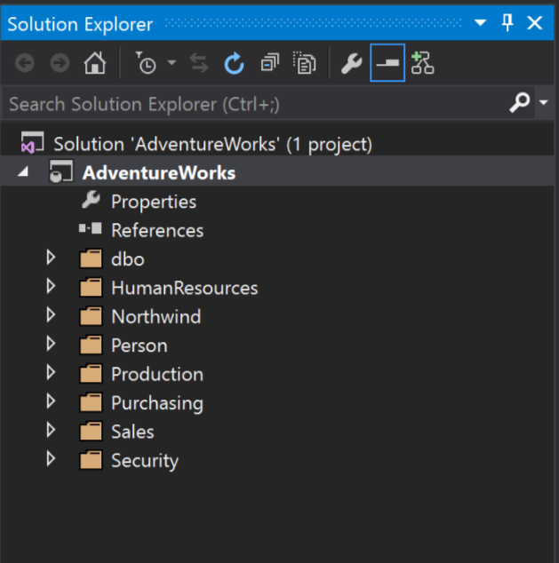
Exploring the Project
Demo
Import creates folders for schema and object types
Objects are saved as CREATE scripts
Database Properties
Renames are handled in the RefactorLog (created when needed)
Notes:
Can create other folders as needed.
I usually create a Scripts/Pre-Deploy and Scripts/Post-Deploy folder, a Publish folder, and a Schema Compare folder

Slide 11
Common Errors and Issues After Import
3-Part DB Names (current database)
Cross-database views/functions/procs
Linked Server references
Users/Logins not often the same in all environments
Notes:
See next slides

Slide 12
Dealing with 3-Part DB Names – Current DB
SSDT doesn’t know the current database name
Find/Replace is your friend
Limit to *.sql files
Variations
DBName.dbo.
DBName..
[DBName].[dbo].
etc.

Slide 13
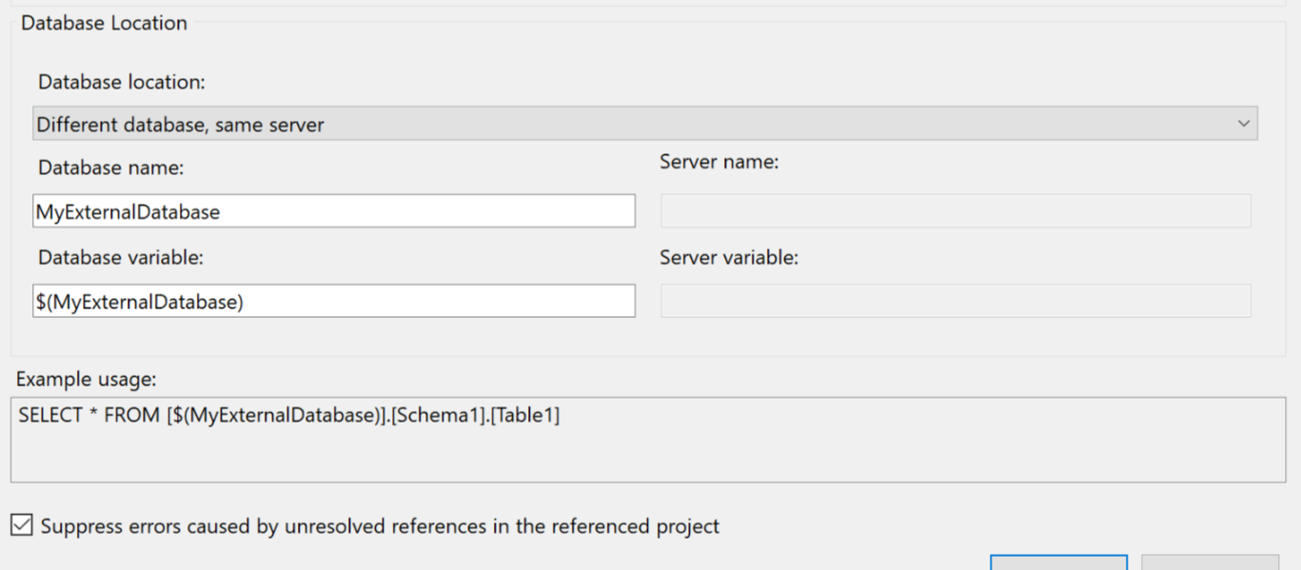
Cross-Database Objects
Database References
Use a common storage location
May need to use SQLPackage to extract a dacpac
Watch your variable settings!
Notes:
Sometimes the import just doesn’t work.
Leave variable blank if DB name will always be the same
Choose “Different Database, Different Server” for linked server dbs
https://msdn.microsoft.com/en-us/library/hh550080(v=VS.103).aspx

Slide 14
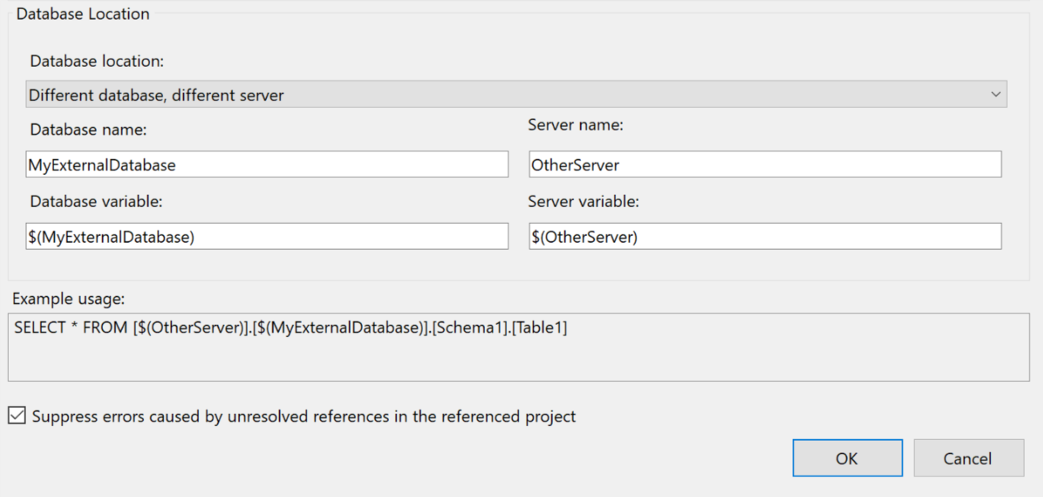
Linked Servers
Similar to Cross-Database objects
Set your options and variables appropriately
Doesn’t seem to work well w/ OPENQUERY

Slide 15
Users/Logins
Easiest to ignore initially
Use DB Roles
Import puts these in the “Security” folder
If you really need this, there are ways…
https://schottsql.com/2013/05/14/ssdt-setting-different-permissions-per-environment/
Kudos to Jamie Thomson for the idea

Slide 16
Back to the Project!

Slide 17
Building and Publishing
Demo
Build
If all obvious errors are fixed, try to build
Fix any errors that come up
Fix warnings as you can
Deploy
Create Publish Profiles for common environments
Pick the appropriate options for your database
Try not to use too many “ignore” options
Notes:
Good way to check the project and make sure that there are no major errors.
Don’t try to push DB Properties to Azure SQL
Allow Incompatible Platform – useful if you could push to many different versions

Slide 18
Adding New Objects
Demo
Watch the file properties (build, none, etc.)
Add as CREATE
Only ALTERs tend to be Constraints and Keys
Try to use standard locations
Follow general folder structure for project
Can also Import or Compare
If an “ignored scripts” file is created, look at it!

Slide 19
Pre and Post Deploy Scripts
Demo
Special script type, only one of each allowed
Uses SQLCMD calls for other scripts
Can use files not in the project

Slide 20
Snapshots
Demo
Saves dacpac of given project state
Possible Uses:
Save a specific version of your project to use for release
Save version of the project before making major changes
Use as a source for schema compare
Baseline your project
Roll back to this state

Slide 21
Version Control
Demo
Similar to other code
Check in non-user-specific files
Can branch, merge, check-out, etc.
If using Git, use a .gitignore file
https://github.com/github/gitignore
Watch out for “*.publish.xml” if saving Publish Profiles

Slide 22
Command Line
Demo
Build using MSBuild or PowerShell
Deploy using SQLPackage or PowerShell
Can generate Diff Reports as part of the process
Useful for gated builds
Notes:
Nuget package w/ SSDT binaries
May want to force a version to avoid surprises

Slide 23
Potential Gotchas
Large numbers of objects
External databases
Users and Permissions
Rollbacks
SQL Server-only features such as FileStream

Slide 24
Where to Get Help
Stack Overflow:
https://stackoverflow.com/questions/tagged/ssdt
MS Forums:
https://social.msdn.microsoft.com/Forums/sqlserver/en-US/home?forum=ssdt&forum=ssdt
SQL Community Slack:
https://sqlps.io/slack/

Slide 25
Questions?
Peter Schott | @paschott
paschott@outlook.com
http://schottsql.com
Files:
https://github.com/paschott/SSDT_101
Rate this presentation:
http://spkr8.com/t/75511

